Slide 1
Ruby Parser
Present By :
Avinash(1PI13IS403)
Brunda B(1P13IS404)
Dakshayini G(1PI13IS405)
Deepak Kumar Adiga(1PI13IS406)
Guided by
Dr:Ganga Holi

Slide 2
Outlines
1.Introduction to LEX and YACC
2.Ruby features and Regular Expression
3.Combing of lex and yacc
4.Resources

Slide 3
What is Lex?
The main job of a lexical analyzer (scanner) is to break up an input stream into more usable elements (tokens)
a = b + c * d;
ID ASSIGN ID PLUS ID MULT ID SEMI
Lex is an utility to help you rapidly generate your scanners

Slide 4
LEX
lex is a program (generator) that generates lexical analyzers, (widely used on Unix).
It is mostly used with Yacc parser generator.
It reads the input stream (specifying the lexical analyzer ) and outputs source code implementing the lexical analyzer in the C programming language.
Lex will read patterns (regular expressions); then produces C code for a lexical analyzer that scans for identifiers

Slide 5
Lex program structure
… definitions …
%%
… rules …
%%
… subroutines …
%{
#include <stdio.h>
#include "y.tab.h"
int c;
extern int yylval;
%}
%%
" " ;
[a-z] { c = yytext[0]; yylval = c - 'a'; return(LETTER); }
[0-9]* { yylval = atoi(yytext); return(NUMBER); }
[^a-z0-9\b] { c = yytext[0]; return(c); }

Slide 6
An Overview of Lex
Lex source program
Lex
lex.yy.c
lex.yy.c
C compiler
a.out
input
a.out
tokens

Slide 7
What is YACC ?
Tool which will produce a parser for a given grammar.
YACC (Yet Another Compiler Compiler) is a program designed to compile a grammar and to produce the source code of the syntactic analyzer of the language produced by this grammar.

Slide 8
How YACC Works
y.tab.h
yacc
YACC source (*.y)
y.tab.c
y.output
(1) Parser generation time
C compiler/linker
y.tab.c
a.out
(2) Compile time
a.out
Abstract
Syntax
Tree
Token stream
(3) Run time

Slide 9
Yacc Program Structure
%{
#include <stdio.h>
int regs[26];
int base;
%}
%token NUMBER LETTER
%left '+' '-‘
%left '*' '/‘
%%
list: | list stat '\n' |list error '\n' {yyerrok;} ;
stat: expr {printf("%d\n",$1);}
| LETTER '=' expr {regs[$1] = $3;};
expr:
'(' expr ')' {$$ = $2;} |
expr '+' expr {$$ = $1 + $3;} |
LETTER {$$ = regs[$1];}
%%
main(){return(yyparse());}
yyerror(CHAR *s){fprintf(stderr, "%s\n",s);}
yywrap(){ return(1);}
… definitions …
%%
… rules …
%%
… subroutines …

Slide 10
Lex v.s. Yacc
Lex
Lex generates C code for a lexical analyzer, or scanner
Lex uses patterns that match strings in the input and converts the strings to tokens
Yacc
Yacc generates C code for syntax analyzer, or parser.
Yacc uses grammar rules that allow it to analyze tokens from Lex and create a syntax tree.

Slide 11
Lex with Yacc
Lex source
(Lexical Rules)
Yacc source
(Grammar Rules)
Lex
Yacc
lex.yy.c
y.tab.c
call
yylex()
yyparse()
Parsed
Input
Input
return token
return token

Slide 12
Variables in a Ruby Class:
Ruby provides types of variables:
  Local variables

Slide 13
Member Functions in Ruby Class:
Syntax:
class Class name
def function name
stms
end
end
Example:
class Sample
def function
statement 1
statement 2
end
end

Slide 14
Arrays
Ruby array are ordered integer-indexed collections of any objects
Ruby array can hold objects such as string, Integer, Hash, Fixnum, Symbol,
every other array objects

Slide 15
Creating Array
Syntax:
Array name = []
Example:
names = [1,2,3,4,5]

Slide 16
Control Structures: Conditionals
if condition then
// code
…
else
…
end

Slide 17
Control Structures: Iteration
For And While
for syntax
for i in exp for(int i=0;i<array.length; i++)
{
//code print(i); }
end
While Syntax Example
while expression i=0
...ruby code here... while i<5
end puts I
                i+=1
                end

Slide 18
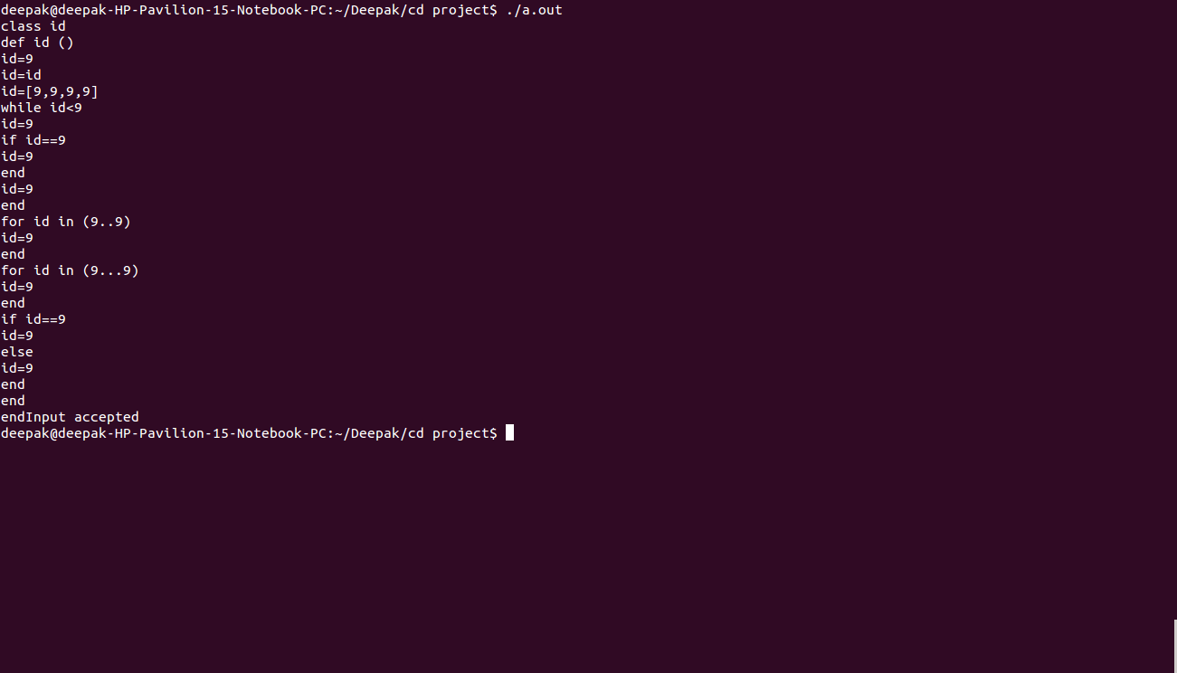
INPUT/ OUTPUT

Slide 19
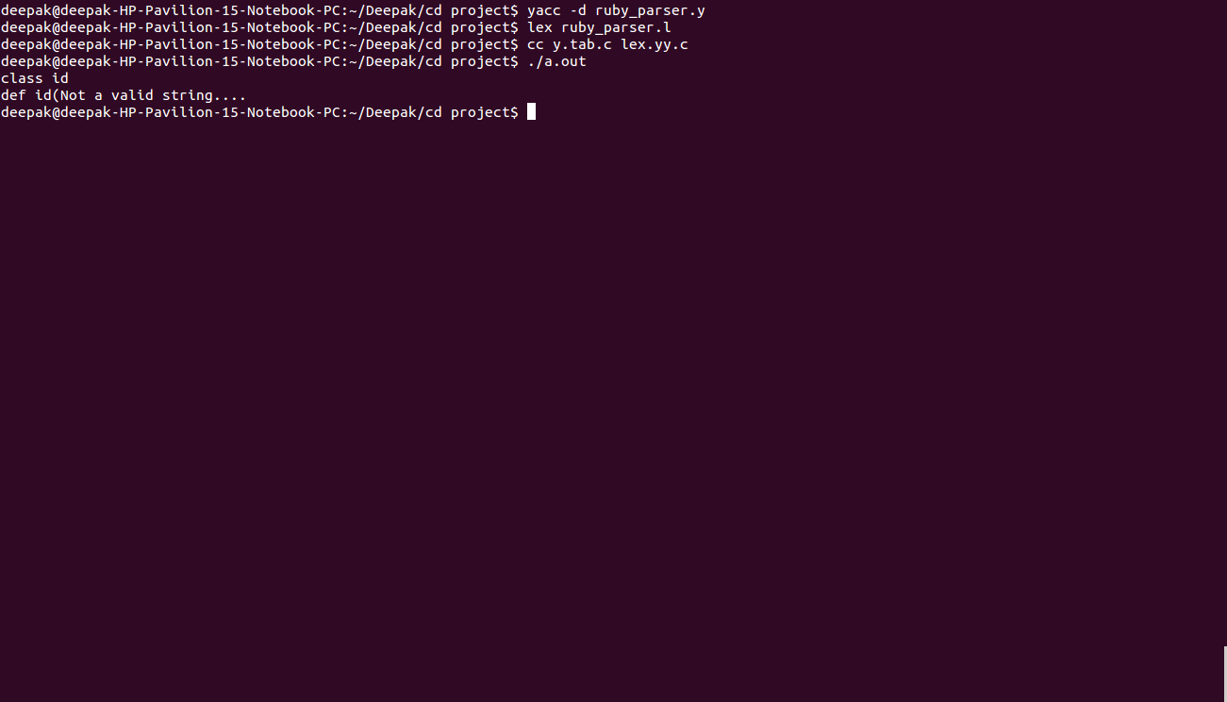

Slide 20
Reference Books
lex & yacc, 2nd Edition
  by John R.Levine, Tony Mason & Doug Brown
Mastering Regular Expressions
  by Jeffrey E.F. Friedl
Www.tutorialpoints.com

